Slide 1
OOP Using Java
By: Ghulam Mujtaba Shaikh

Slide 2
JDBC
PART-III

Slide 3
Topics for Discussion
Introduction to Result set
Default Result set
Next () method
Getter Methods
Close () Method
Updateable and/or Scrollable Result set
Previous () Method
Absolute () method
Updater Methods
UpdateRow () Method
MoveToInsertRow () Method
insert Row () Method
last () and first () methods
getRow () and deleteRow () Method

Slide 4
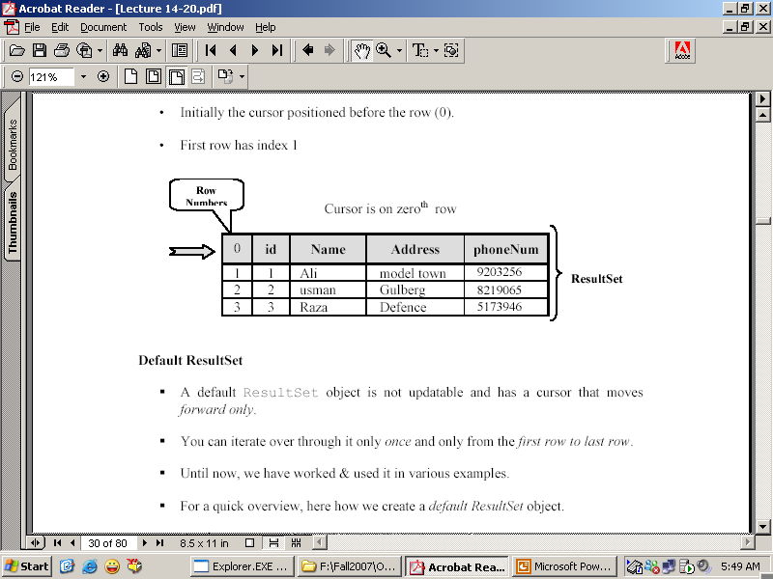
Result Set
Contains the result of the SQL query.
Represented by a table with rows and column
Maintains a cursor pointing to its current row of data.
Initially the cursor points to row 0.
First row has index 1.

Slide 5
Default Result set
Not updateable
Cursor is forward only
Already we have used and created
For recap
String sql = “Select * from Person”
PreparedStatement pstat = con.prepareStatement (sql)
ResultSet rs = pstate.executeQuery () ;

Slide 6
Useful default Result Set Methods
next ()
Getter Methods like
  getString () ;
  getInt () ; etc
close ()

Slide 7
Updateable and / or Scrollable Result Set
It is possible to produce a result set which is updateable and scrollable
In this we can move forward, backward, update any row, insert any row and delete any row.

Slide 8
Creating Updateable and / or Scrollable Result Set
String sql = “Select * from Person” ;
PreparedStatement pstat = con.prepareStatement (sql,ResultSet.TYPE_SCROLL_INSENSITIVE,ResultSet.CONCUR_UPDATEABLE) ;
ResultSet rs = pstate.executeQuery () ;

Slide 9
Useful Methods of Creating Updateable and / or Scrollable Result Set
previous ()
absolute (int)
Updater Methods () like
  updateString (StringColumnName,String Value)
  updateString (int Column Index, String Value)
  updateInt (parameter1 , parameter2) etc..
updateRow ()
moveToInsertRow (int) ;
insertRow () ;
last (), first ()
getRow () , deleteRow ()

Slide 10
Example showing the navigation of next and previous records

Slide 11
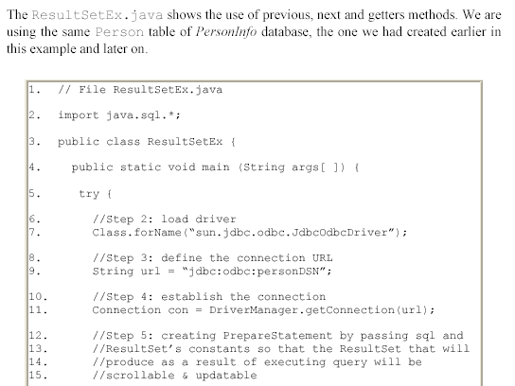

Slide 12
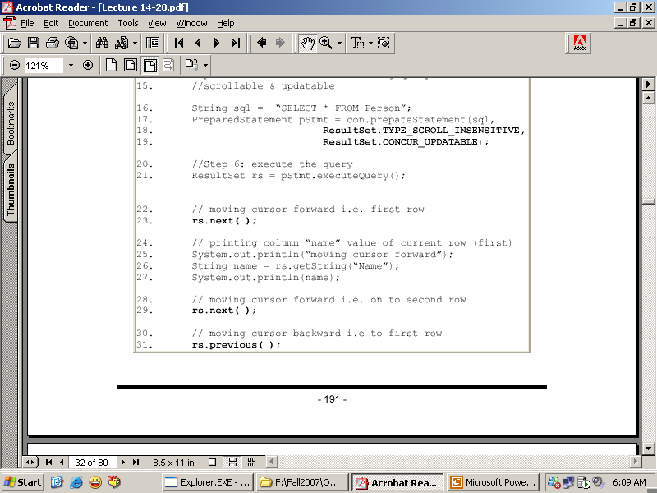

Slide 13
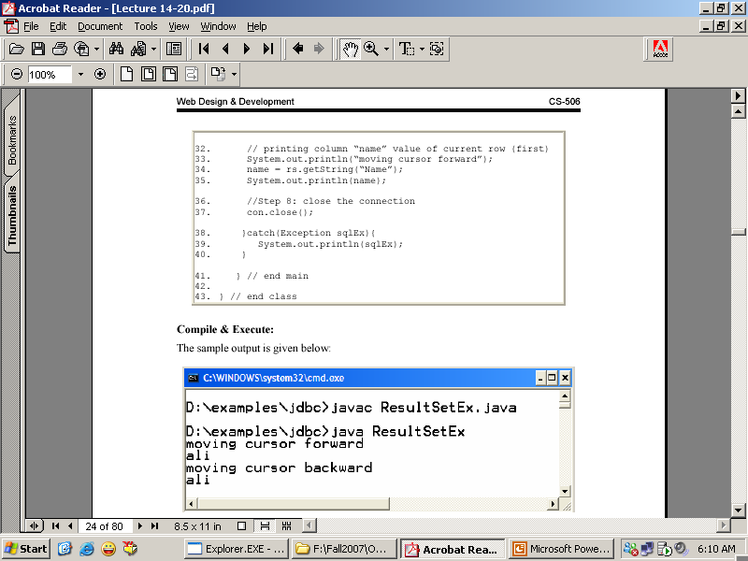

Slide 14
Example showing the updation of values in existing rows

Slide 15
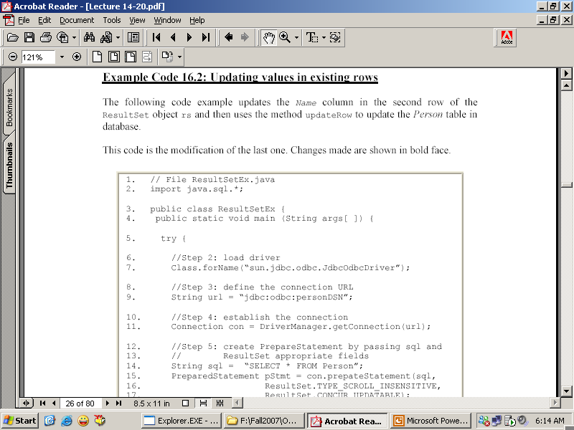

Slide 16
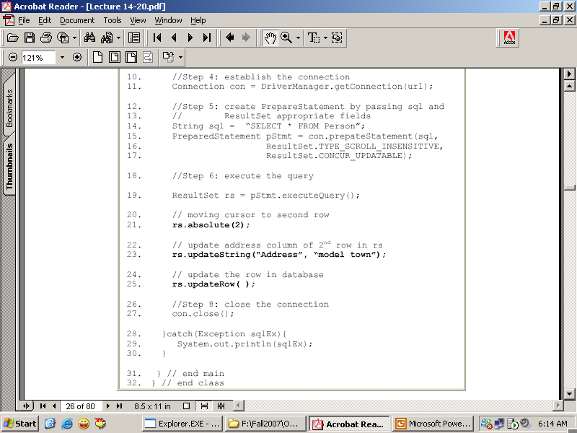

Slide 17
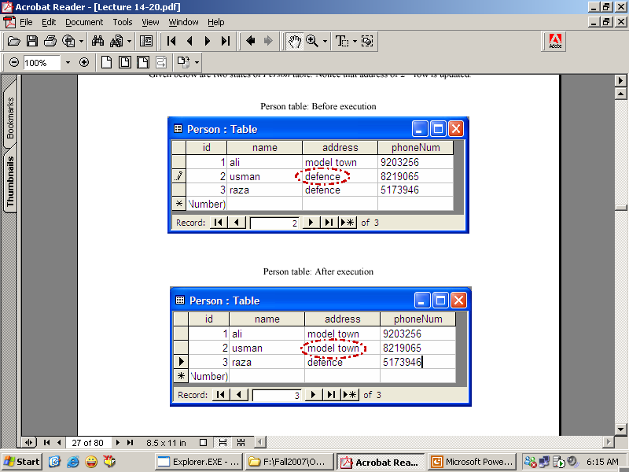

Slide 18
Inserting record in the database
moveToInsertRow (int) method
An updateable result set object has an special row associated with it i.e insert row
Insert row is a buffer where a new row may be constructed by calling updater methods
Doesn’t insert a row into a result set or in a database
Now insert the row into the result set and database by calling the method insertRow () ;
Insertion is the three steps process
  Call moveToInsertRow () Method
  Call the Updater methods to update the values of the row.
  Call the insertRow () method

Slide 19
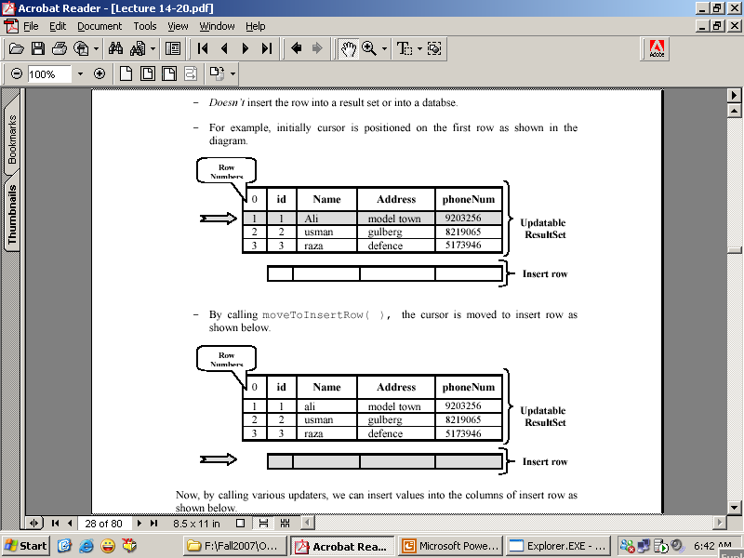
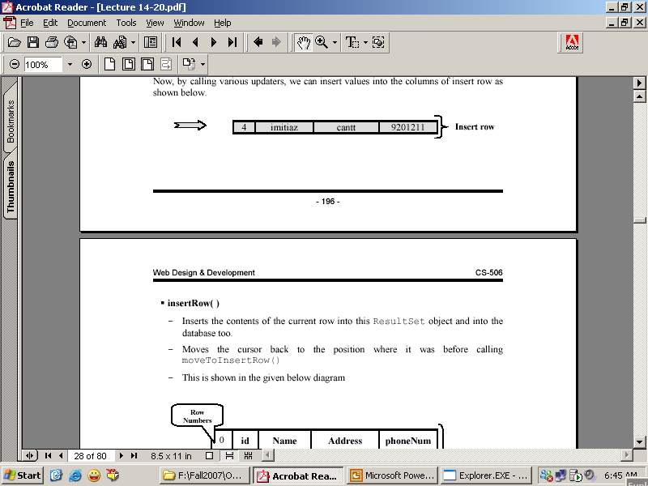
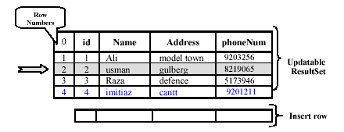
After calling the updater methods

Slide 20
Example showing the insertion of new record in the result set and Data Base

Slide 21
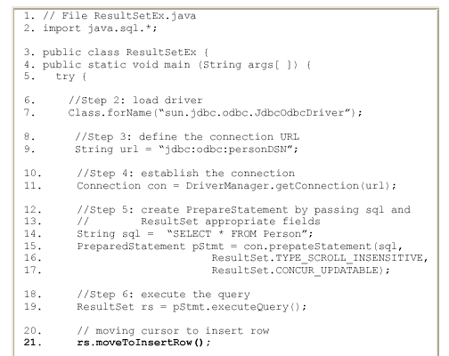

Slide 22
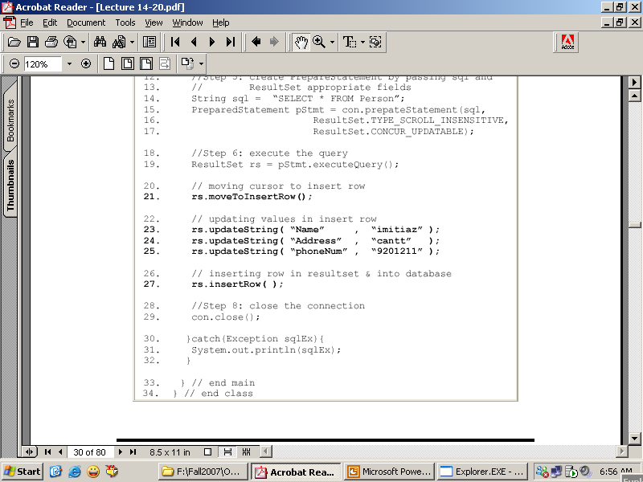
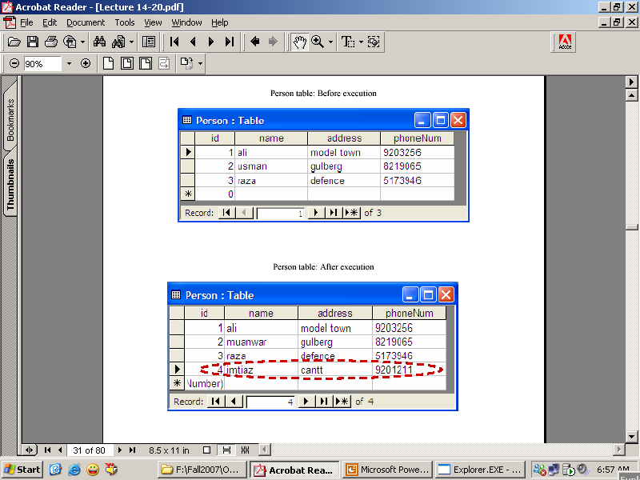

Slide 23
Example showing the deletion of new record in the result set and Data Base by using the deleteRow () method

Slide 24
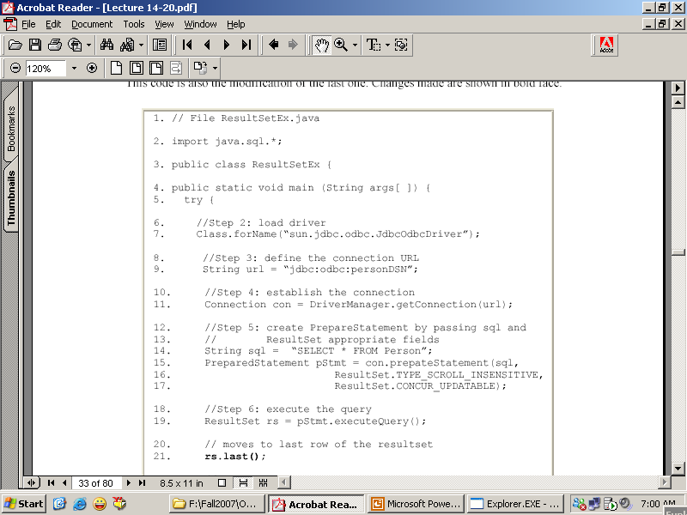

Slide 25
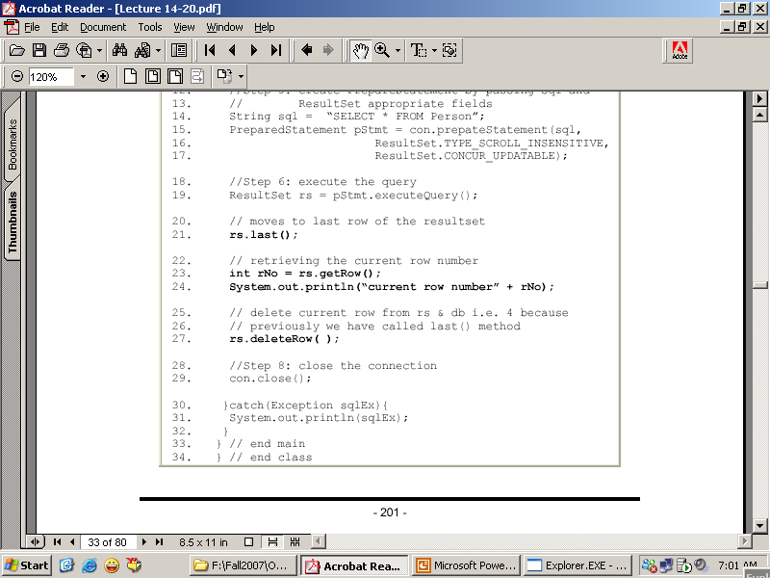

Slide 26
